Slide 1

OUR IDEA !
OPEN DISCUSSION PLATFORM FOR COLLEGE STUDENTS AND TEACHERS

Slide 2
PROBLEM??
Problem- In large number of colleges there is no concrete system for internal communication and students use to make their own group network on whatsapp, facebook etc. According to us when we join an institute we become a member of a new society and for communication within the society there must be a technological method for communication.

Slide 3

Solution- Carbon Pie (slack like)
1. Group chat concept for each branch divided into channels.
2. Create channel(group) and start chat .
3. Even teachers can join and share files.
4. You can like the post follow.
5. Forward (share) post also available.
6. Notification feature(just like fb).

Slide 4

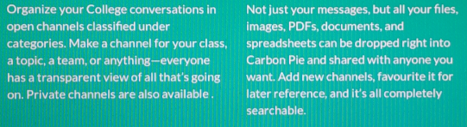
Concept Behind Our Idea

Slide 5






THE WAY WE DID IT
LANGUAGES USED
PHP
JQUERY
JAVA SCRIPT
AJAX
MYSQL (DATA BASE)
BOOTSTRAP

Slide 6


FEATURES
Category System
Categories divided into many private and
public channels (groups)
Trending groups (channels)

Slide 7
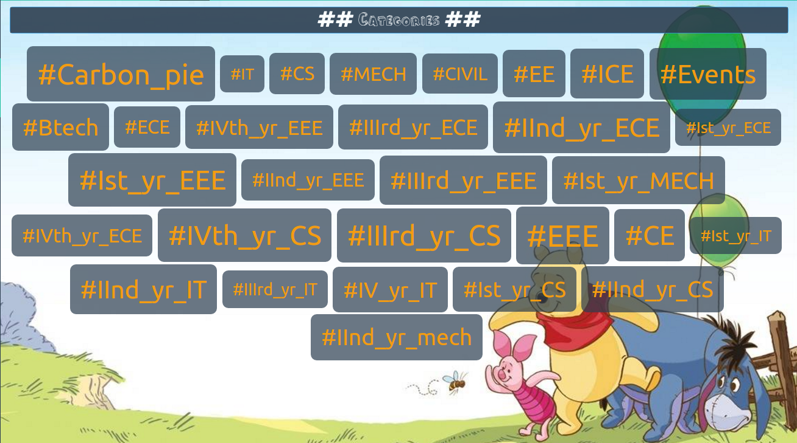

Slide 8
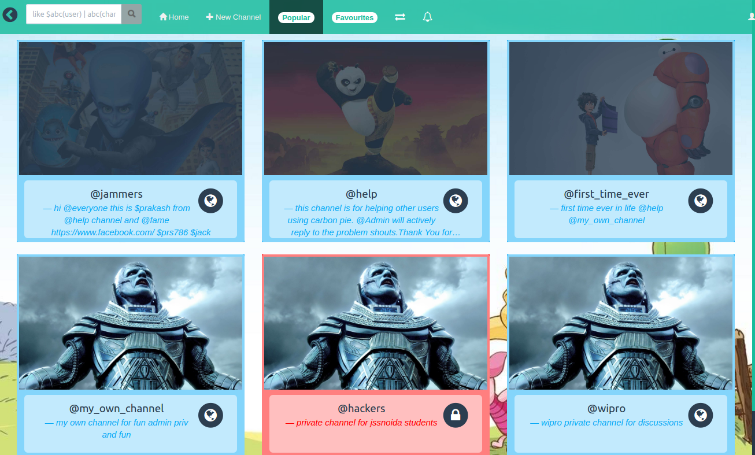
INSIDE CATEGORIES

Slide 9
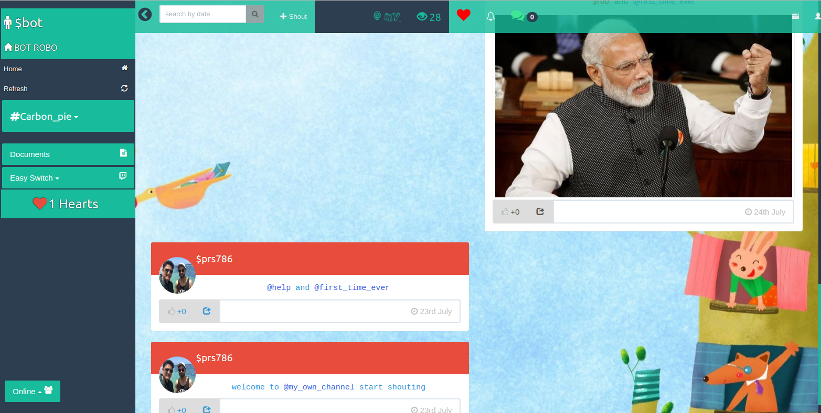
GROUP CHAT

Slide 10

Followers
Follow others and get followed

Slide 11
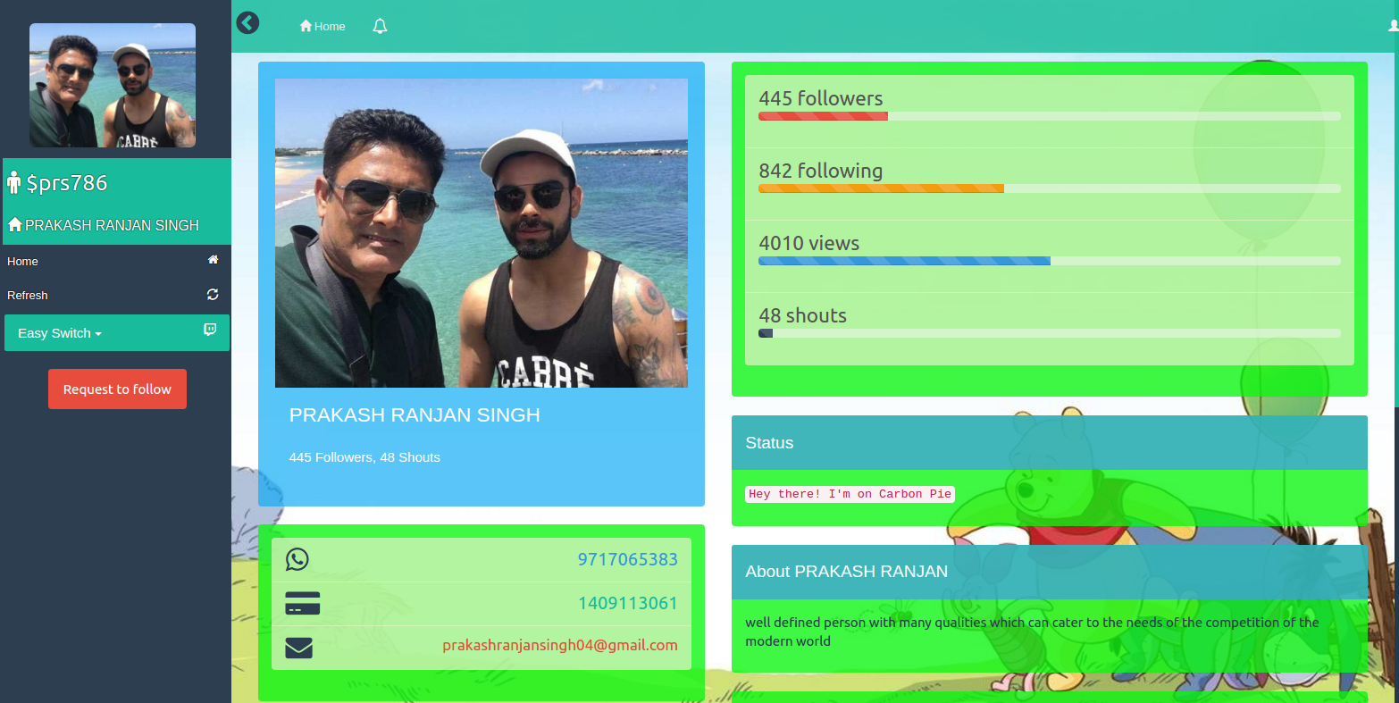

Slide 12

Notifications
Shouts notification of texts, images and videos of joined groups.
Shouts notifications to students classified among university , college , branch, year , class .

Slide 13
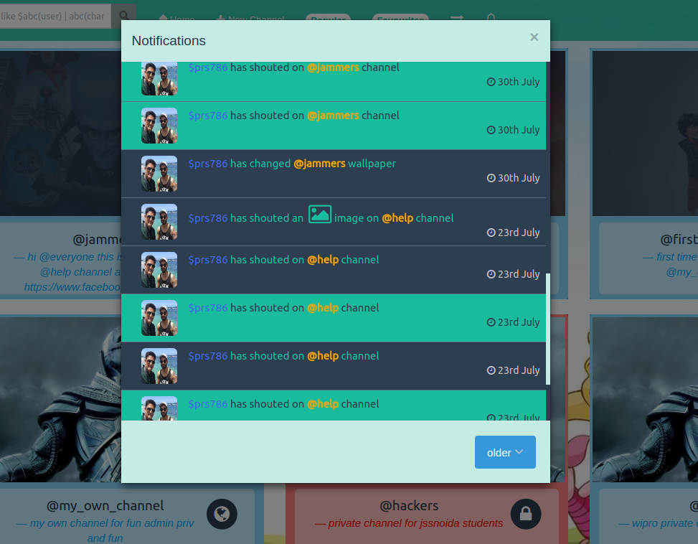

Slide 14
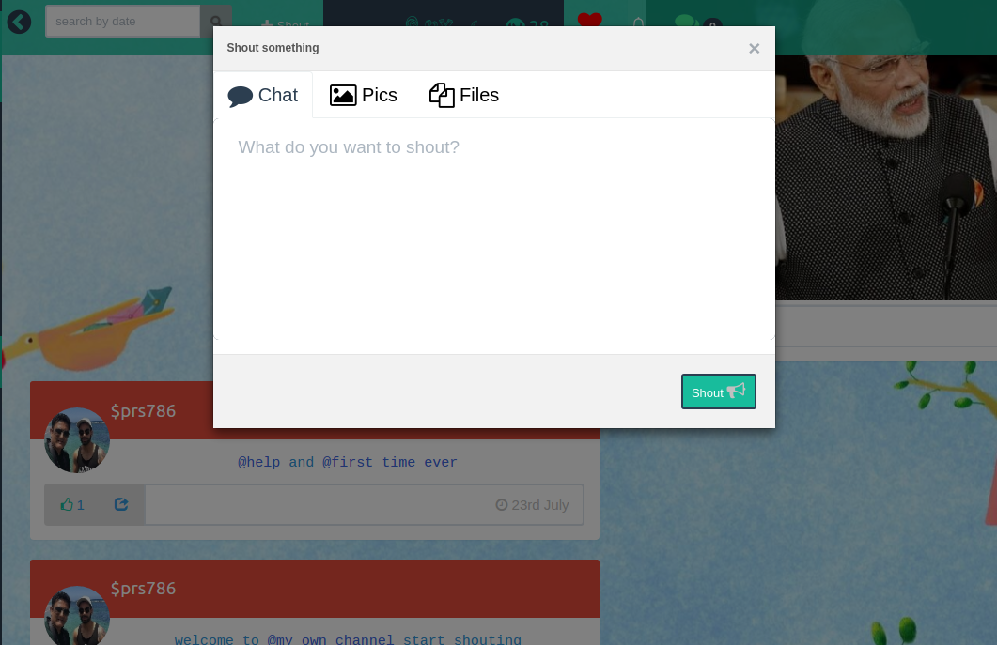
SHOUT

Slide 15


ANONYMOUS shout option , which gives freedom to share things without being recognised.

Slide 16
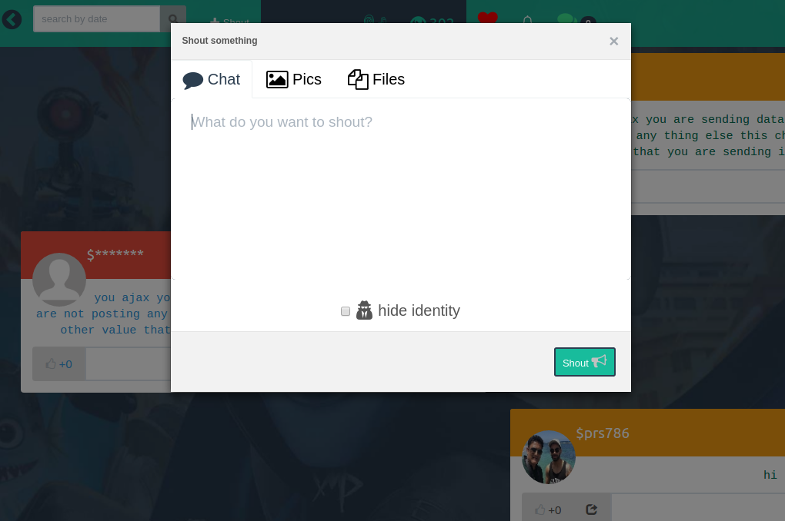

Slide 17
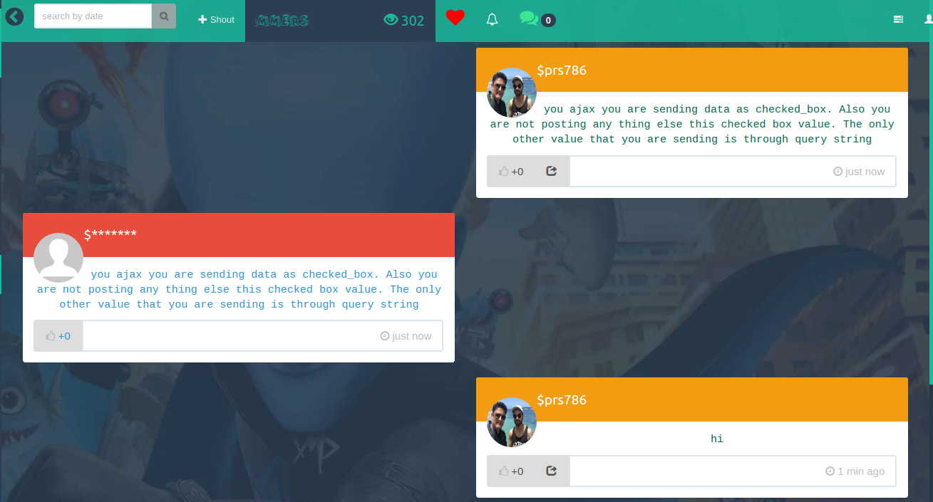

Slide 18
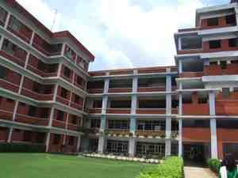

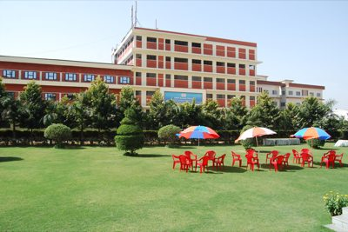
Specific Registration
Limited to the colleges and Universities only.
Registration can only be made by students who have enrolled in any college mentioned in our list, having specific enrolment number given by the college, eg. 1409113061 .

Slide 19
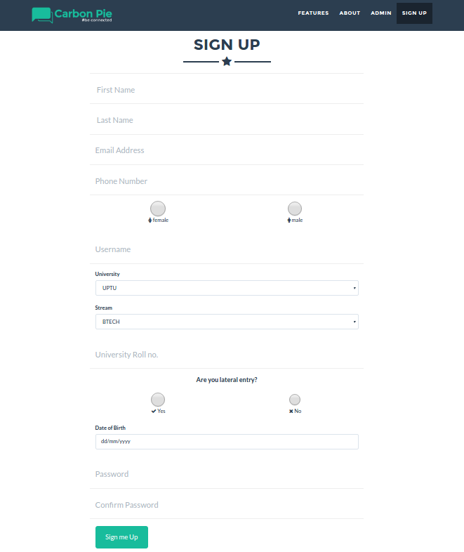

Slide 20



ADD ON FEATURES
GROUP DOMINANCE
The teacher or student who makes the maximum posts will have group dominance which will motivate others to participate more.

Slide 21

HANGOUT SESSIONS
A teacher can decide a Hangout Session and inform the students by posting about it in the group.

Slide 22

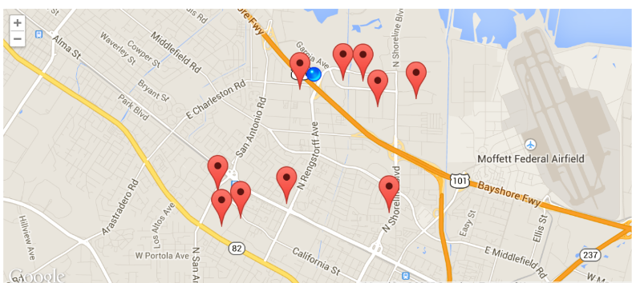
GROUP MEET UPS
Anyone who wants to present something about any topic or share something innovative or different can call for a GROUP MEET UP (like an event) at a convenient place with the help “Google maps Geo Location API”.

Slide 23
THANKYOU

